Slide 1
Molten Salt Reactors and Thorium Utilisation
Monazite sand in Kerala beach
Prototype Fast Breeder Reactor
Srikumar Banerjee
Homi Bhabha National Institute
Bhabha Atomic Research Centre
Nuclear Energy Conclave, India Energy Forum
18 October, 2019

Slide 2
Energy Potential of Indigenous Fissile and Fertile Materials
Uranium +Thorium Deposit: 3,00,000 + 8,00,000 = 11,00,000 Tonnes (Metal)
Electrical Energy produced in one cycle 11,00,000 T x 60,000 MWtd/T
(With 40 % thermodynamic efficiency) 6.4 x 10¹⁴ kWh per cycle
In 10 Recycles (possible in Breeder Reactors
with Breeding Ratio~ 1.03 & 3% Loss) 6.2 x 10¹⁵ kWh
India ‘s stabilised population 1.7 x 10⁹
Annual consumption(Today’s world average) 3000 kWh per capita
Sufficient for 1200 years, if all energy comes from nuclear
Sufficient for 6000 years, If 20 % comes from nuclear

Slide 3
Fuel cycle options
Fuel
Fissile+Fertile
Nuclear Reactor
Fissile partly spent
Fertile partly converted
Spent Fuel Repository
Huge energy potential !!
Once Through Fuel Cycle
Fuel
Fissile+Fertile
Fissile partly spent
Fertile partly converted
Reprocessing
Nuclear Reactor
Fuel Manufacturing
Fertile + Fissile
Long lived waste Repository
Closed Fuel Cycle

Slide 4
Conversion from Fertile to Fissile Materials
n
²³²Th
γ
²³³Th
β
²³³Pa
β
²³³U
Fertile
Fissile
²³⁸U
γ
²³⁹U
β
β
²³⁹Np
²³⁹Pu
n
Fertile
Fissile

Slide 5
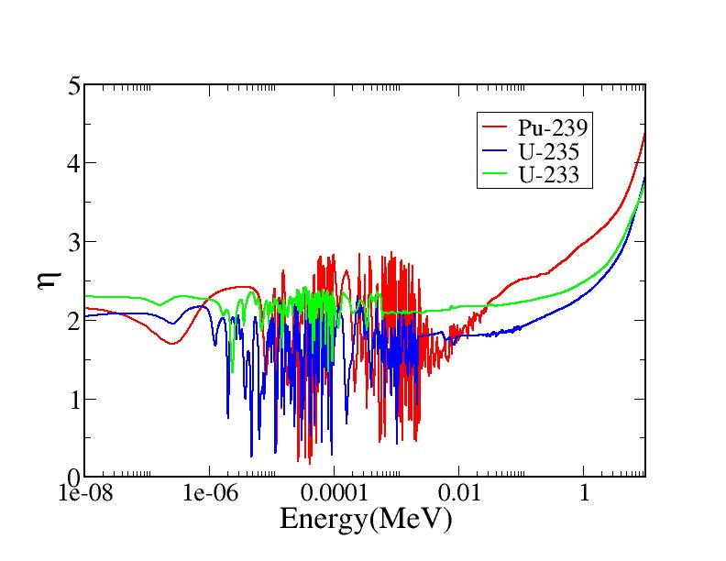
Variation of η with neutron energy
η =
Total neutrons produced in fuel due to fission
Thermal neutrons absorbed in fuel

Slide 6
Development of Molten Salt Breeder Reactors
The fuel is in the molten salt form
(Li⁷F, BeF₂, ThF₄, UF₄) circulated
through the heat exchangers and
reprocessed online
Air craft Reactor Experiment
(ARE) 1954, 2 MWt
Molten Salt Reactor Experiment (MSRE)
(ORNL, 1965-1969); 8 MWt
all three fissile nuclides tested
Single Fluid MSBR (Breeding ratio 1.04) and Two fluid MSBR 1000 MWe designed (Breeding ratio 1.07) using thorium fuel
Alvin Weinberg (1915- 2006)

Slide 7
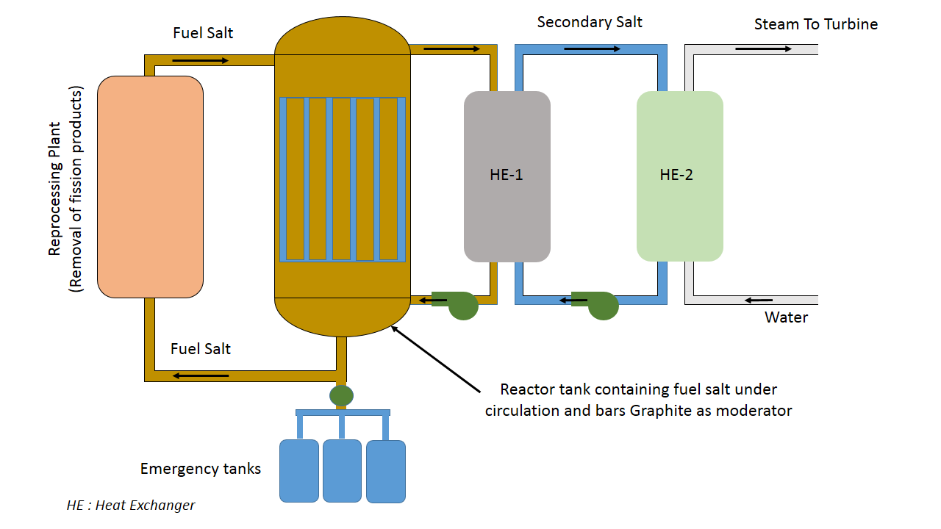
Molten Salt Reactors (MSR)
Molten salt(Li⁷F, BeF₂, ThF₄, UF₄) fuel circulated through heat exchangers and reprocessed online
Enhanced safety due to large difference between melting point and boiling point (500º C and 1400º C) near ambient operating pressure
High thermal efficiency due to high operating temperatures
On line removal of poisons and fissile addition result in gain in reactivity and neutrons- minimum excess reactivity in the reactor
As fuel is in the molten state, melt down accident is of no concern
Passive dumping of fuel by melting of freeze plug

Slide 8
Summary of Molten Salt Reactors
If only gaseous fission products are removed high conversion ratio of the order of 0.94 can be obtained
If all the fission products are removed and protactinium is also separated and stored separately, molten salt breeder are possible
ORNL single fluid design has B.R. ~ 1.04
ORNL two fluid design has B.R. ~ 1.07
Molten salt fast reactor design studies are also in progress as η is higher
Use of chloride may keep the spectrum harder than fluoride
Reactor Doubling Time can be of similar order in thermal breeder reactor compared to fast reactor even with smaller breeding gain due to smaller specific fissile inventory in thermal reactors
Molten Salt thermal breeder reactors will have very good fuel utilisation

Slide 9
Advantage of protactinium removal
Protactinium Pa²³³ if remains in high flux region in reactor will absorb a neutron, Pa²³⁴ will be formed which by beta decay converts to U²³⁴. So a neutron is lost and U²³³ is also not produced. Thus there is a double loss
U²³³ produced is free of U²³²
half life of Pa²³³ is 27 days

Slide 10
Breeding in Molten Salt Thermal Reactors with Thorium
Online removal of poisons, and protactinium enhances the conversion ratio
Single Fluid MSBR (Breeding ratio 1.04) and Two fluid MSBR 1000 MWe designed (Breeding ratio 1.07) using thorium fuel. Recent report claims, BR nearly 1.1
Thorium
Molten Salt Reactor
No external fissile feed needed in equilibrium
Reprocessing
Protactinium
Fission products
U²³³
Self sustaining thorium cycle

Slide 11
Why Thermal Breeder is attractive?
Fast breeder reactor
4 Ton fissile
1 GWe
F.P
600 kg Pu
+D.U./year
1 GWe
Reprocessing
plant
Fabrication
plant
FBR
B.R.=1.2
DoublingTime
22 years
PHWR
170 T
N. U./year
170 T/year
Spent fuel
Reprocessing
Molten Salt breeder reactor
1 ton fissile
F.P
1 GWe
1 GWe
200 kg U²³³
+Th / year
120 T
N. U./year
6 Ton
En. U
Enrichment
plant
PHWR /
AHWR
Reprocessing
plant
MSBR
B.R.=1.05
22 years
20 T/ year Spent fuel
14 Ton Thorium
Reprocessing plant

Slide 12
Thorium Fuel Cycle Reduces Nuclear Waste Burden
10⁹
Production of minor actinides in U and Th fuel cycle in g/t of heavy metals at 60 GWD/t
U²³⁵ - Pu Fuel Cycle
-
10⁸
10⁷
10⁶
After Separation of TRU
Minor actinide (g/T) | U²³⁵ + U²³⁸ | U²³³ +Th²³²
Np | 900 | 3
Am | 470 | 0.0018
Cm | 220 | 0.00064
10⁵
Natural U Ore
10⁴
Radiotoxicity of Spent Fuel
10³
10²
U²³³ - Th Fuel Cycle
By virtue of being
lower in the periodic
table than uranium,
the long-lived minor
actinides in spent
fuel are in much lower
quantity with the
thorium cycle.
10¹
10¹
10²
10³
10⁴
10⁵
10⁶
10⁷
Decay Time (Years)
Radio-toxicity of spent fuel against time for U²³⁵ - Pu, U²³⁵-Pu (minor actinides removed) and Th-U²³³ fuel cycles
Amit Rajora, etal.,ThEC-2015, , Mumbai, India, October 12-15, 2015

Slide 13
Some Drawbacks of MSBRs
Dimensional changes in graphite hence frequent replacement; Zirconium hydride is considered as moderator in recent designs in place of graphite
Safety parameter β^{eff} low due to fuel circulation
Better structural materials to hold molten fluorides to prevent radioactivity leaks, Hestalloy-N was developed
Radioactivity in primary circuit, needs retention, cooling under all situations

Slide 14
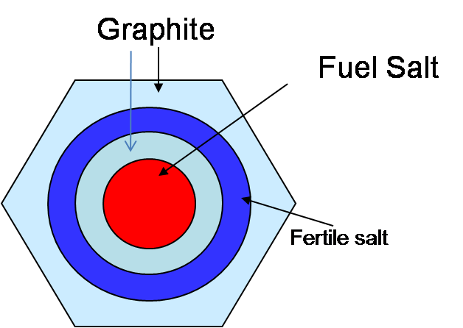
Breeding in Molten Salt Thermal Reactors with Thorium
Online removal of poisons,
and protactinium enhances
the conversion ratio
Fuel salt (Th-U)
Purified
salt
Graphite
Reprocessing
plant
Molten Salt Reactor
U²³³
Protactinium decay tank
Fission products
Two fluid MSBR 1000 MWe
Single Fluid MSBR (Breeding ratio 1.04) and Two fluid MSBR 1000 MWe designed
(Breeding ratio 1.07) using thorium fuel. Recent report claims, B.R. nearly 1.1

Slide 15
Concluding Remarks
Revival of interest in Molten Salt Reactors in Several Countries
India’s special interest due to the possibility of early introduction of Thorium
Breeding possible in thermal spectrum, with doubling time comparable with fast reactors
Feasibility of Construction of a wide range of sizes
Inherently safe design
Thank You for your Attention

